Slide 1

StringTracker
Team 9: Jairo Cruz, William Dobson, Jenny Liu, Amanuel Zelealem

Slide 2
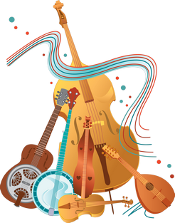
Introduction
String Tracker - a database app for Android that allows players of stringed instruments to track:
String set usage
Life expectancy
Optional user sentiments over time
For any number of instruments and string sets.

Slide 3
Group Roles
Jairo Cruz
powerpoint
Use-cases
Back-end
William Dobson
System design
Database
Back-end
Jenny Liu
UI design
Back-end
Front-end
Amanuel Zelealem
Database
Back-end
Front-end

Slide 4


Communication & Planning/Scheduling
Communication
Discord
Teams
Discord and Teams were our primary methods of communication.
We would have weekly meetings on Discord using voice-chat, video-streaming, and image sharing.
We would video call each other and collaborate.
Planning
and
Scheduling
We would meet 1-3 times per week to touch base with each other and share information.
We had a chat divided into sections to keep our live communications sorted.
We used a shared Google Drive to hold notes, task lists, and designs.
We assigned tasks and set deadlines.

Slide 5
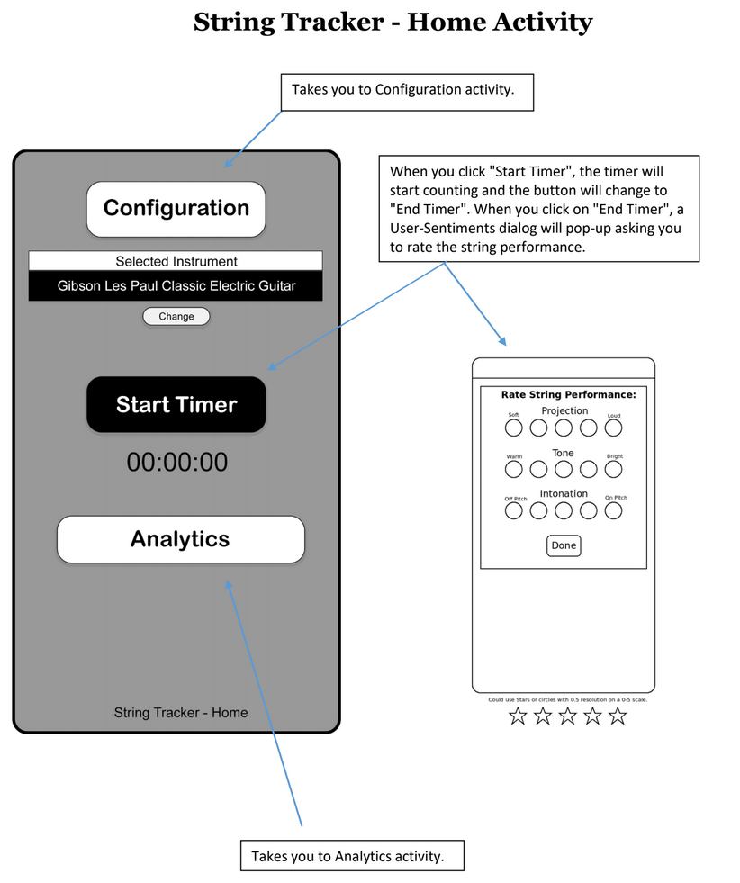
App Planning: UI Design
While app planning we came up with a UI design to help guide us when developing the UI for the app.
Home Activity

Slide 6
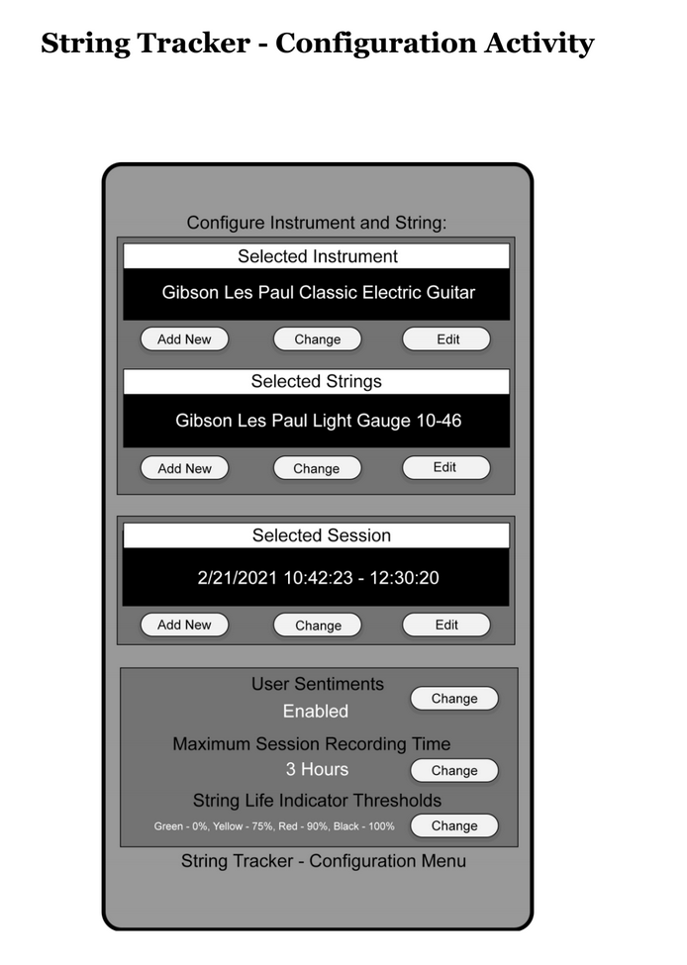
App Planning: UI Design
The Configuration Activity

Slide 7
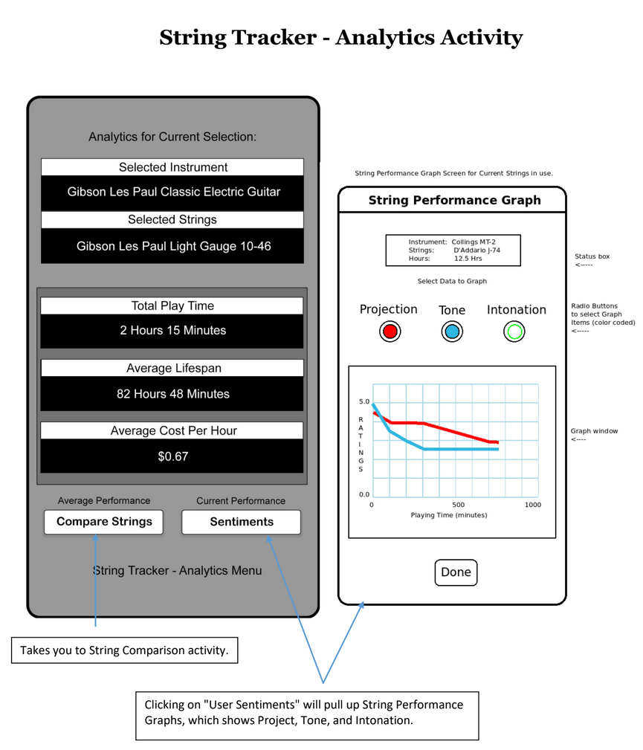
App Planning: UI Design
Analytics Activity

Slide 8
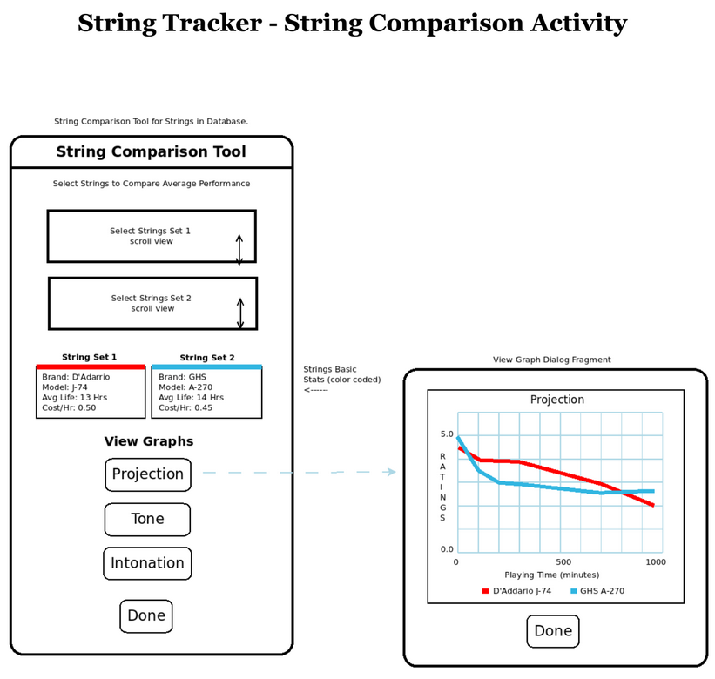
App Planning: UI Design
String Comparison Activity

Slide 9
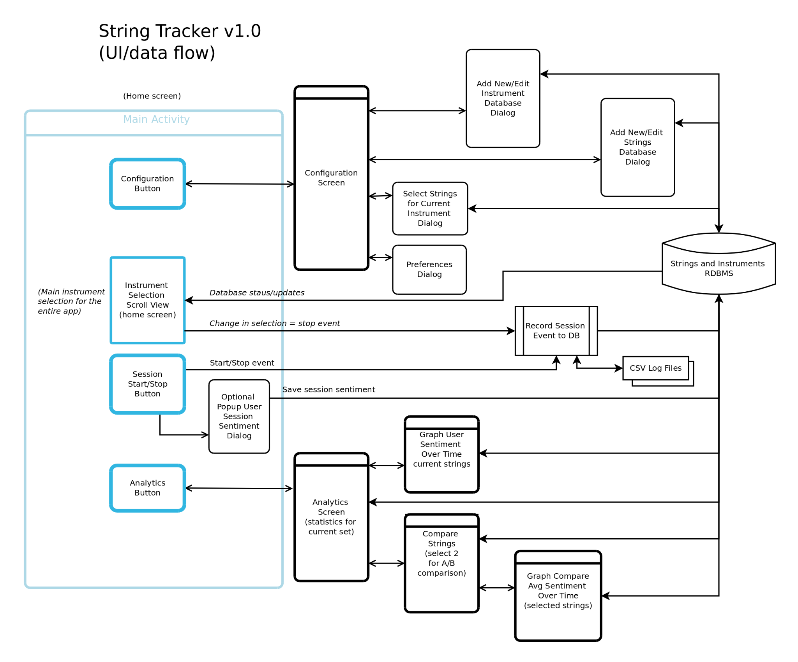
App Planning: Flowchart

Slide 10
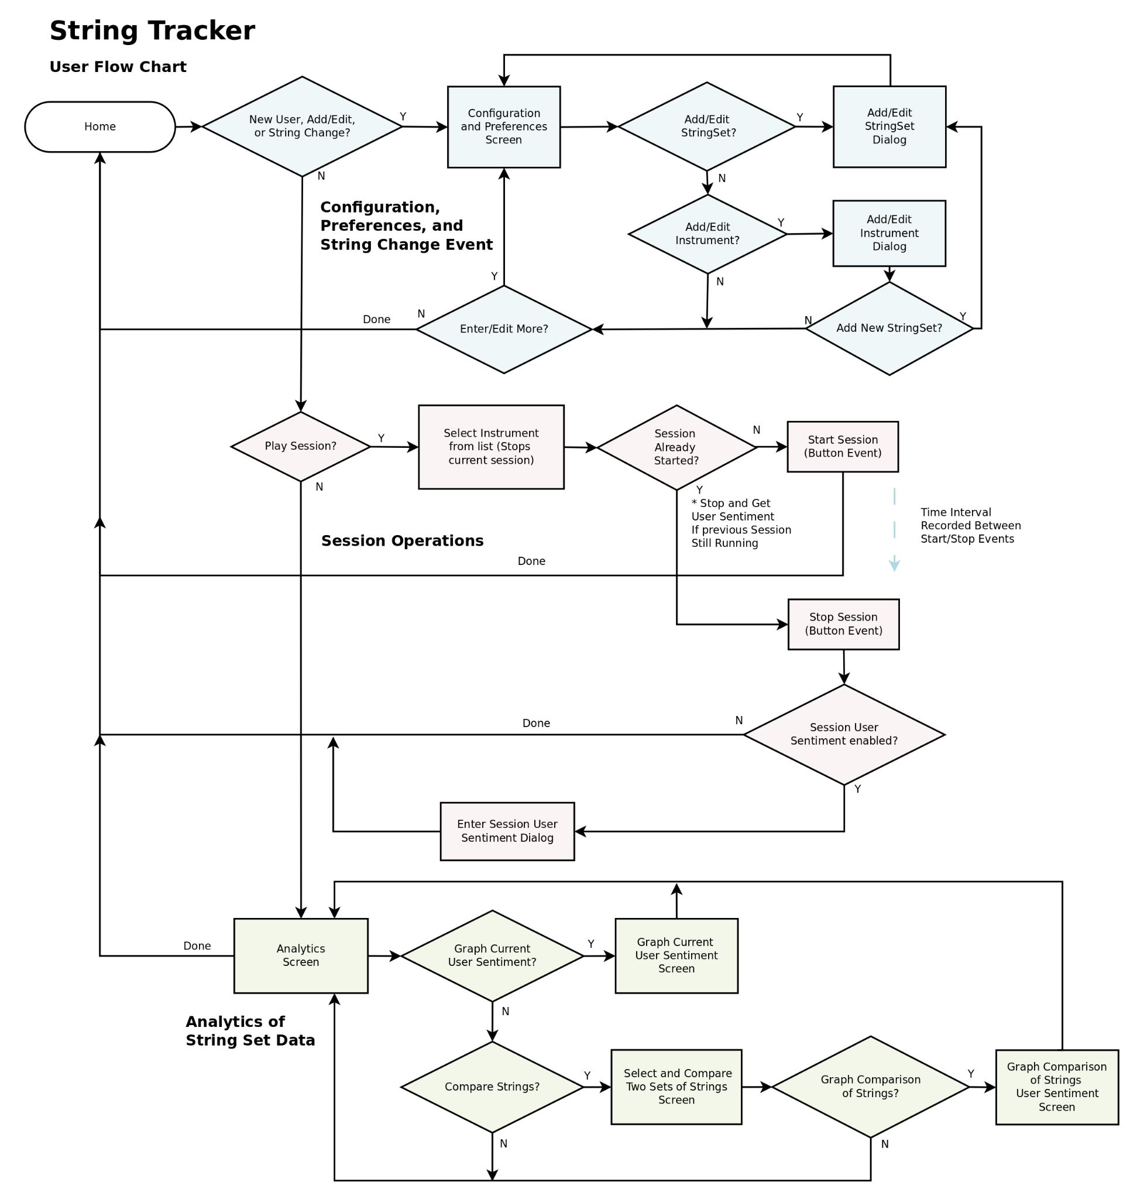
App Planning: Flowchart

Slide 11
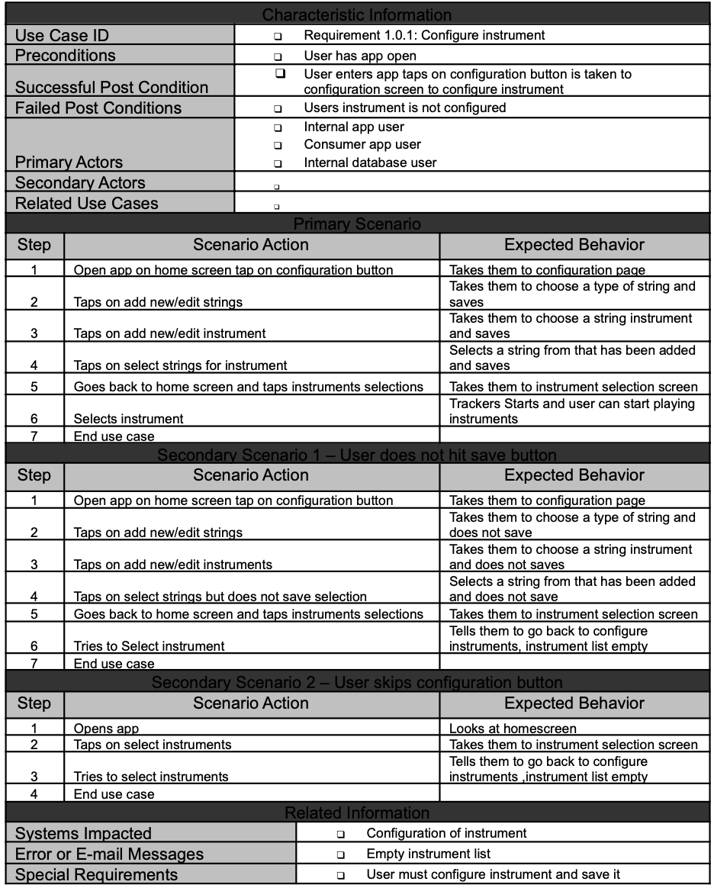
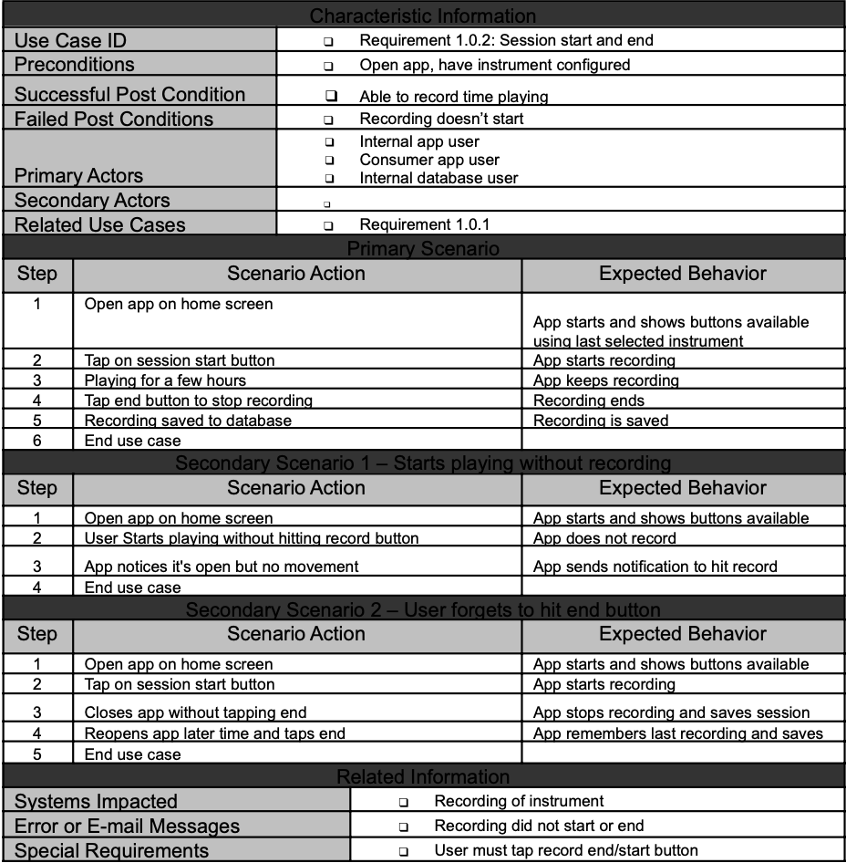
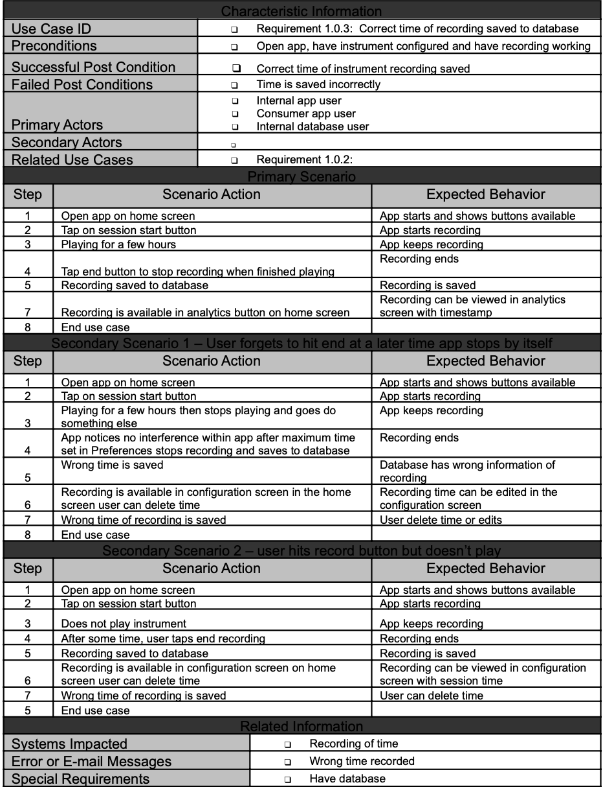
App Planning: Use Cases

Slide 12
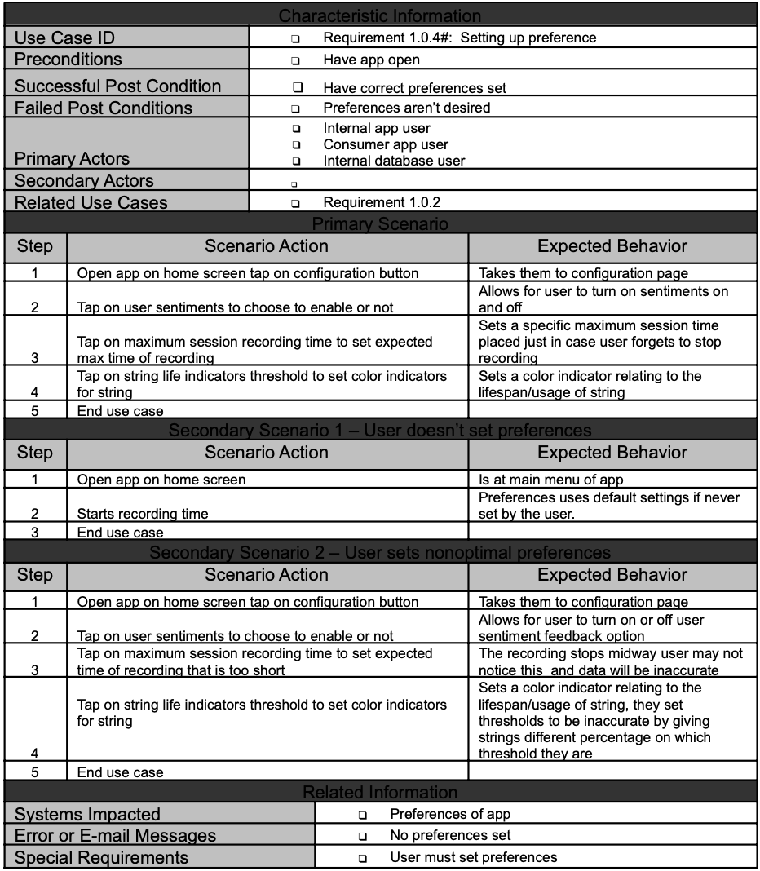
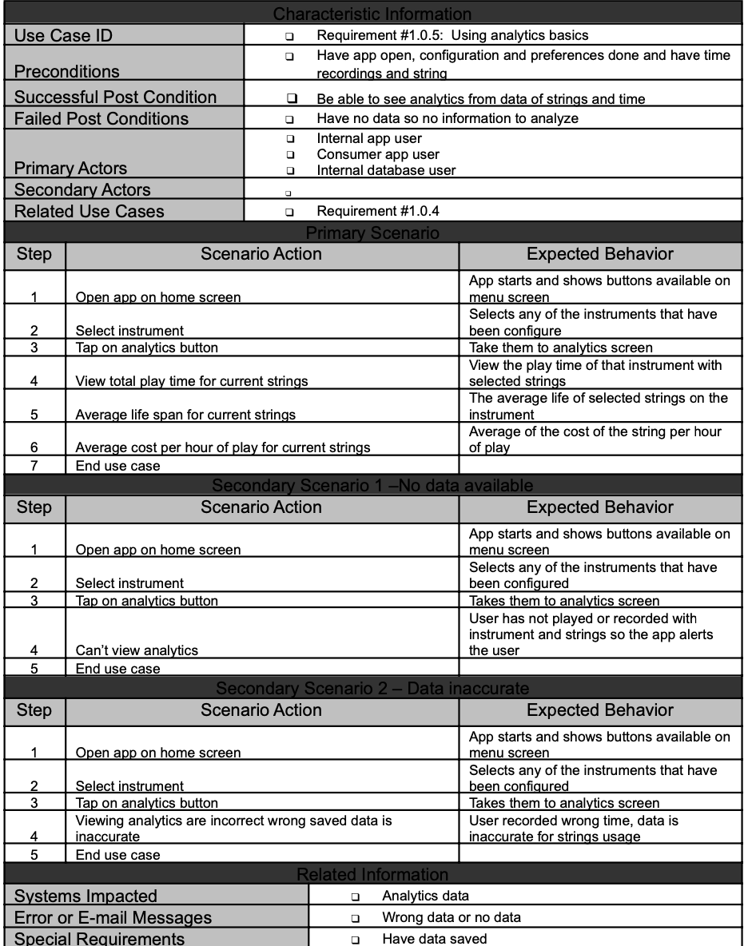
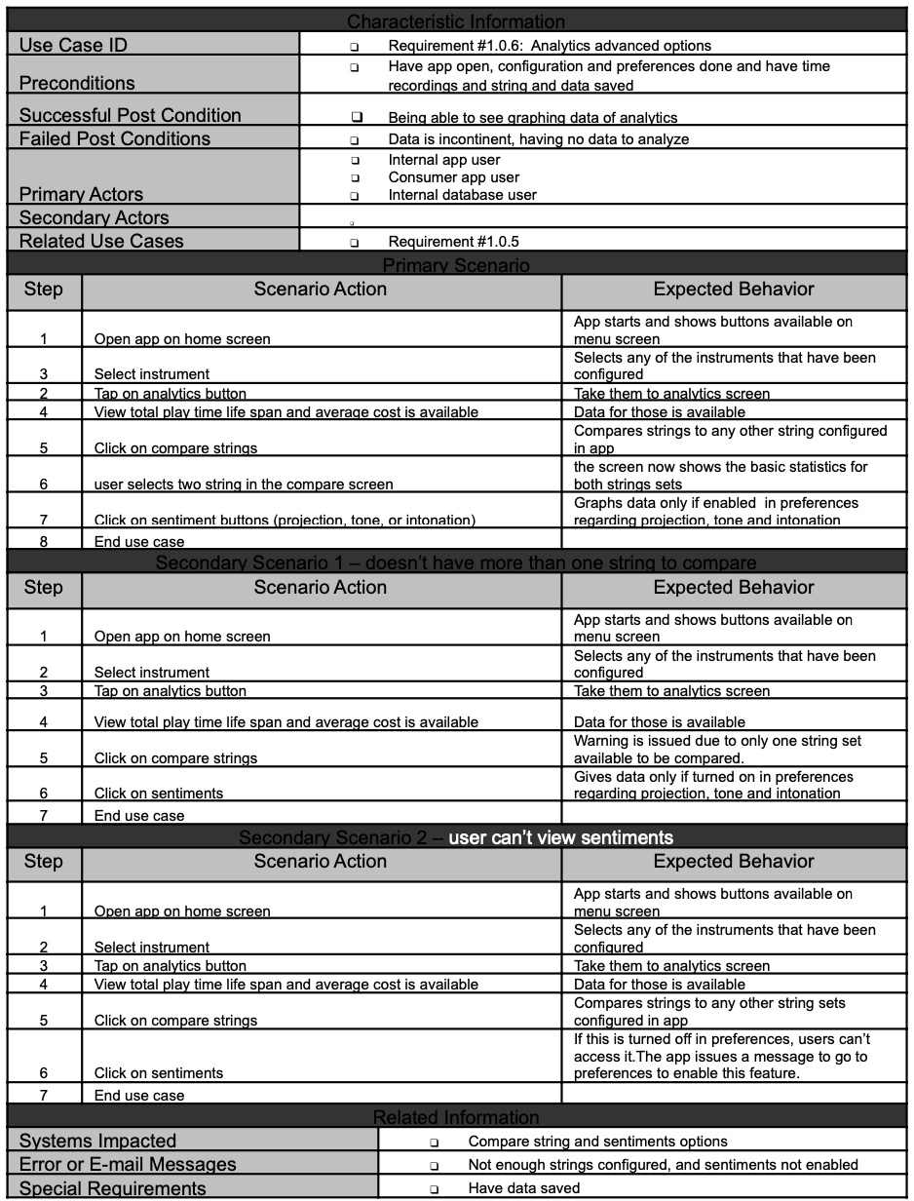
App Planning: Use Cases

Slide 13




App Planning: Tech Stack
Android Studio
1
SQLite
2
Java
3
Github
4
MPAndroidChart Library
5

Slide 14
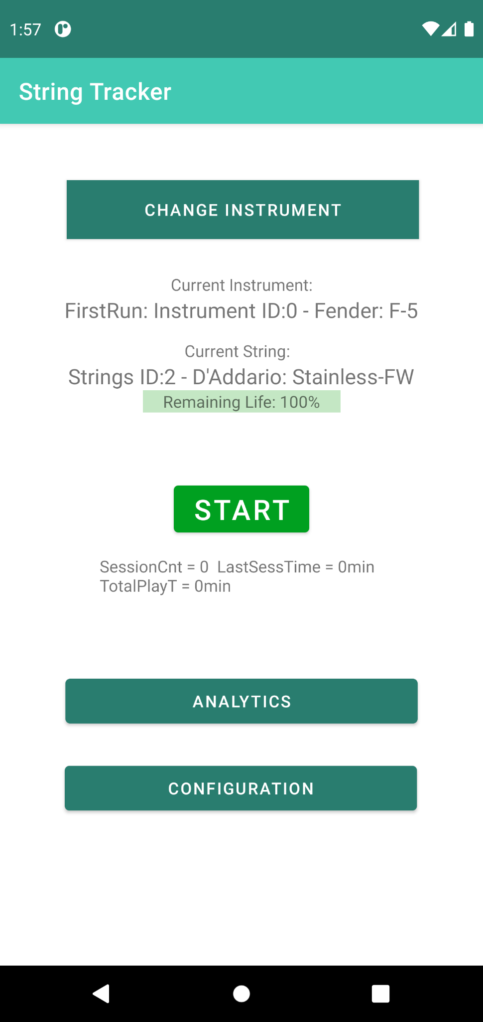
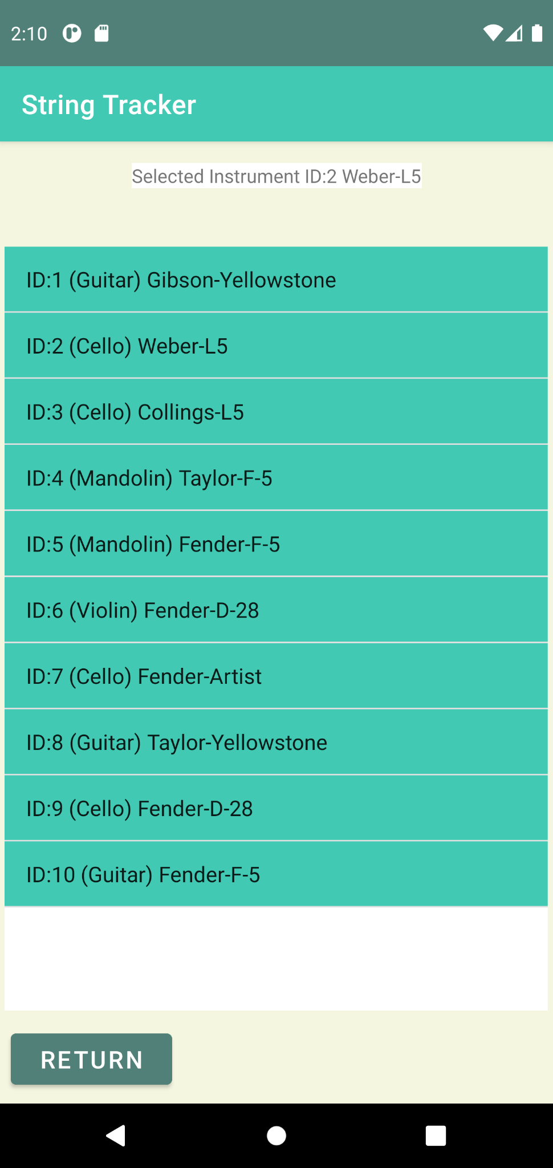
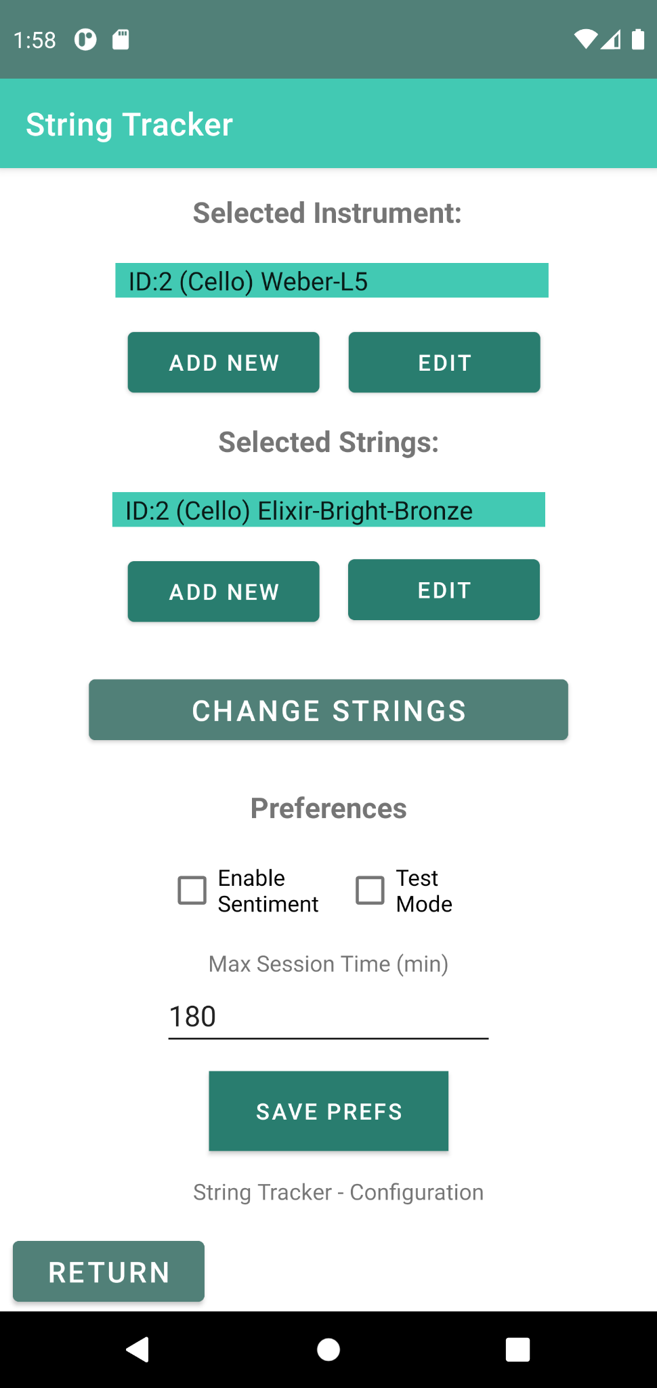
Implementation: Showcase (Main Menu Items)
Homescreen
Select Instrument
Configuration

Slide 15
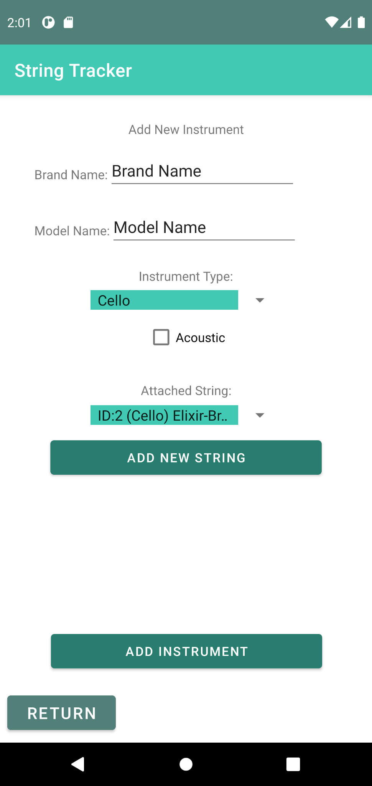
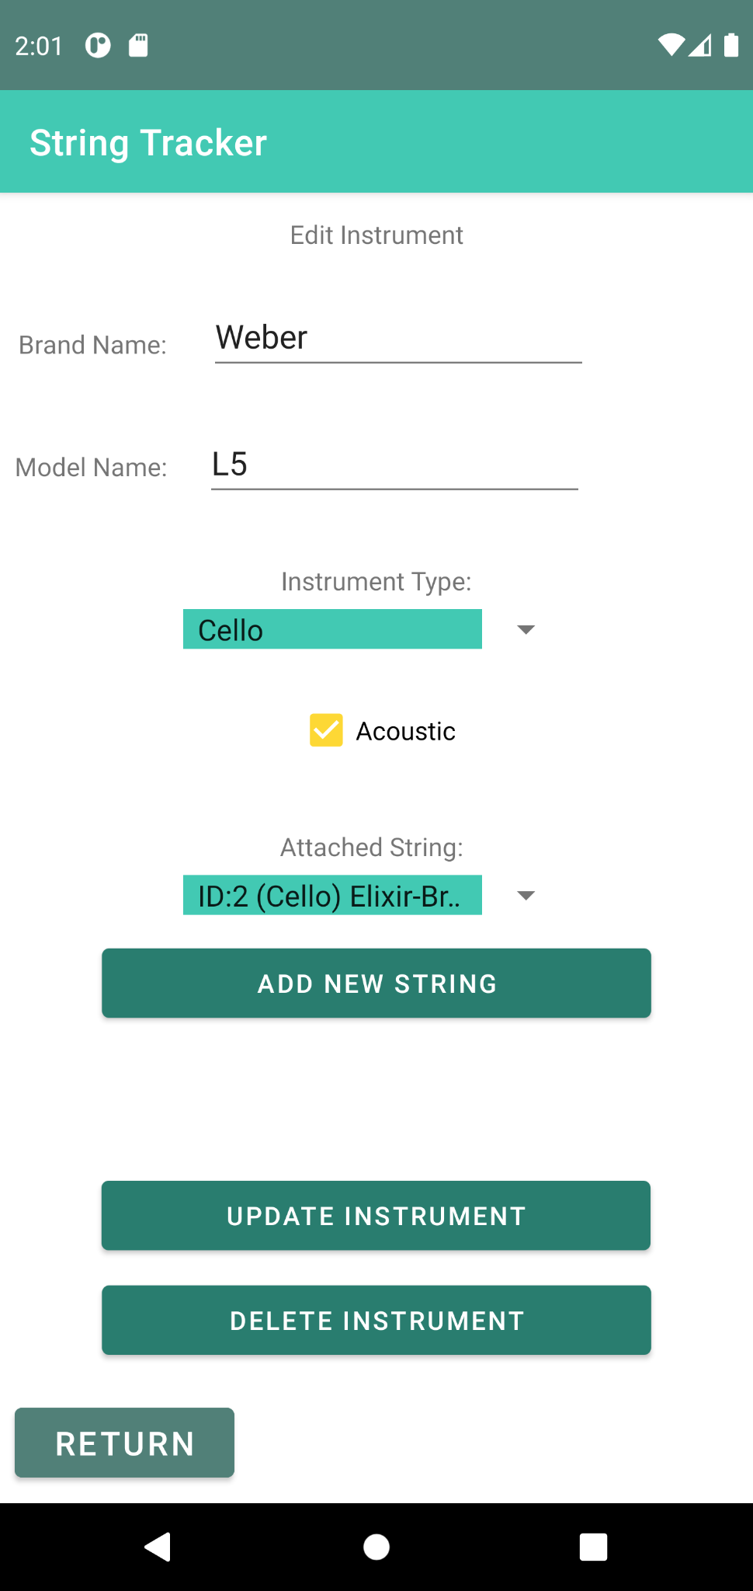
Implementation: Showcase (Instrument Add & Edit)
New Instrument
Instrument edit

Slide 16
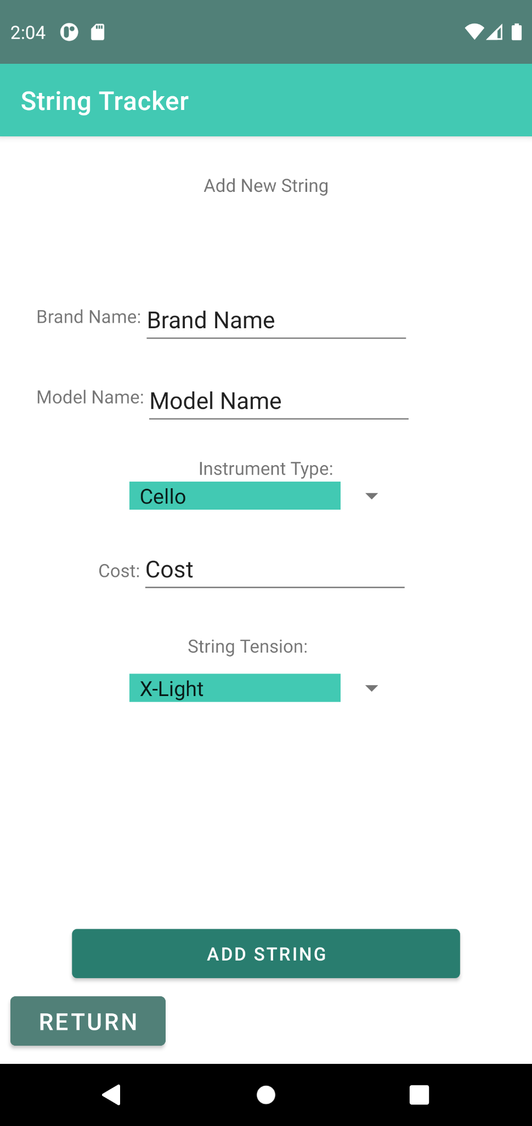
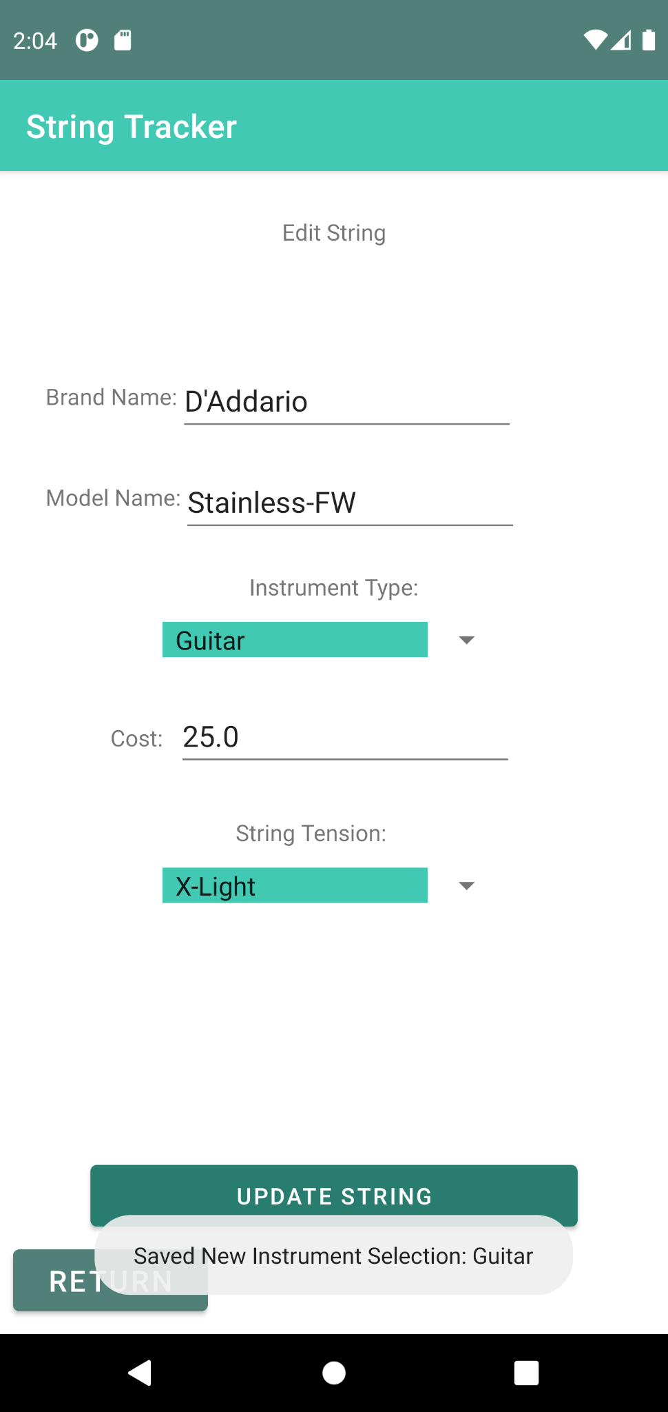
Implementation: Showcase (String Add & Edit)
Add new string
Edit string

Slide 17
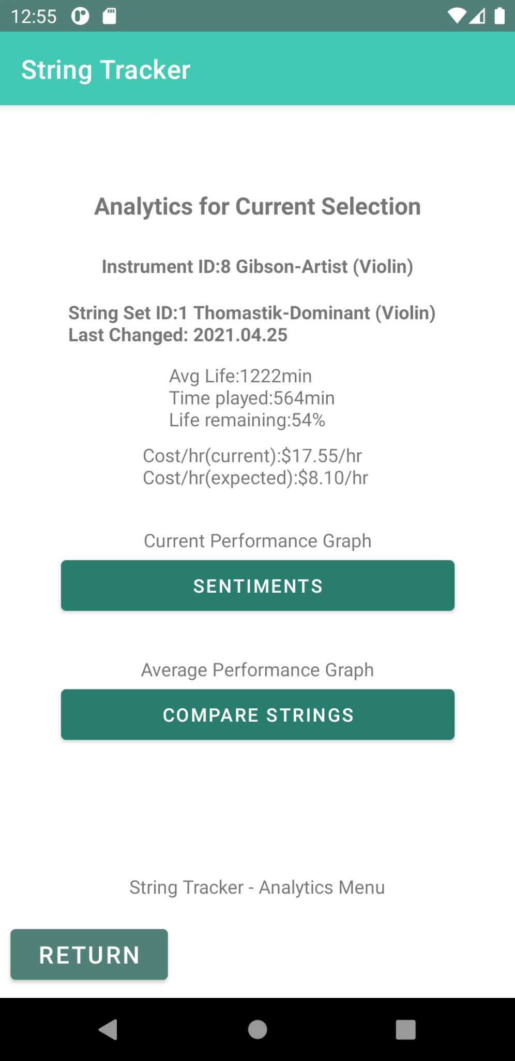
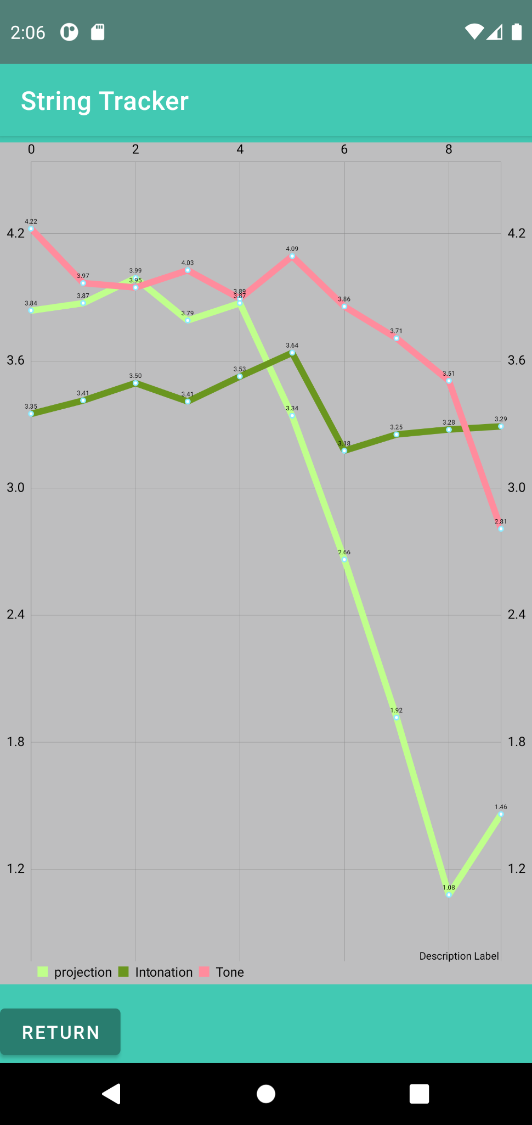
Implementation: Showcase (Analytics Overview)
Analytics Screen
Analytics Graph

Slide 18
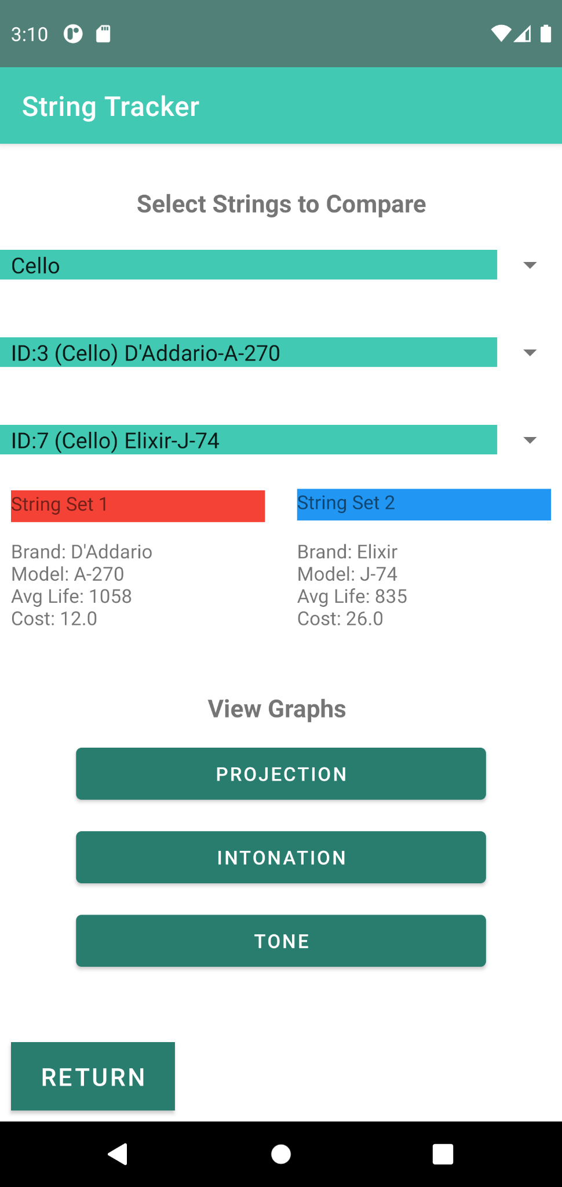
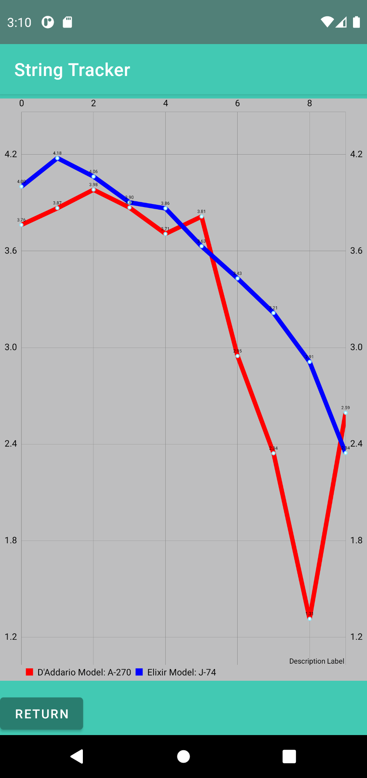
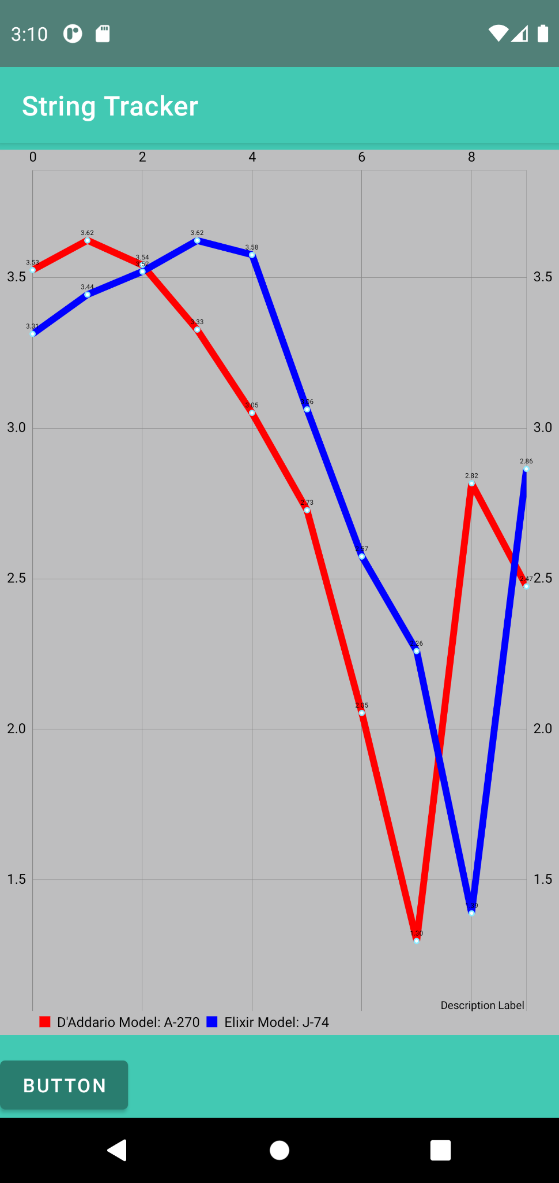
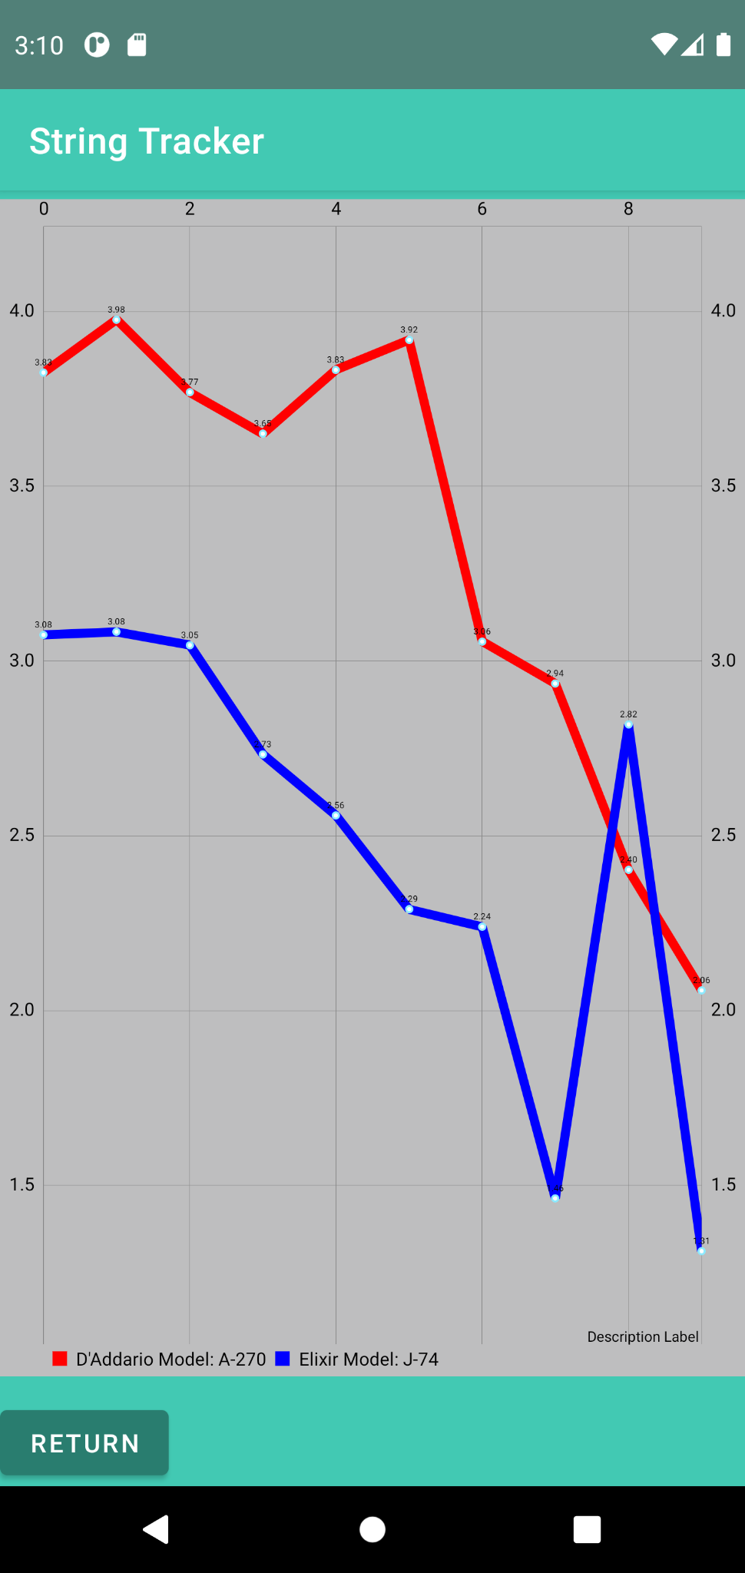
Implementation: Showcase (Graphs)
Compare Menu
Projection Graph
Intonation Graph
Tone Graph

Slide 19
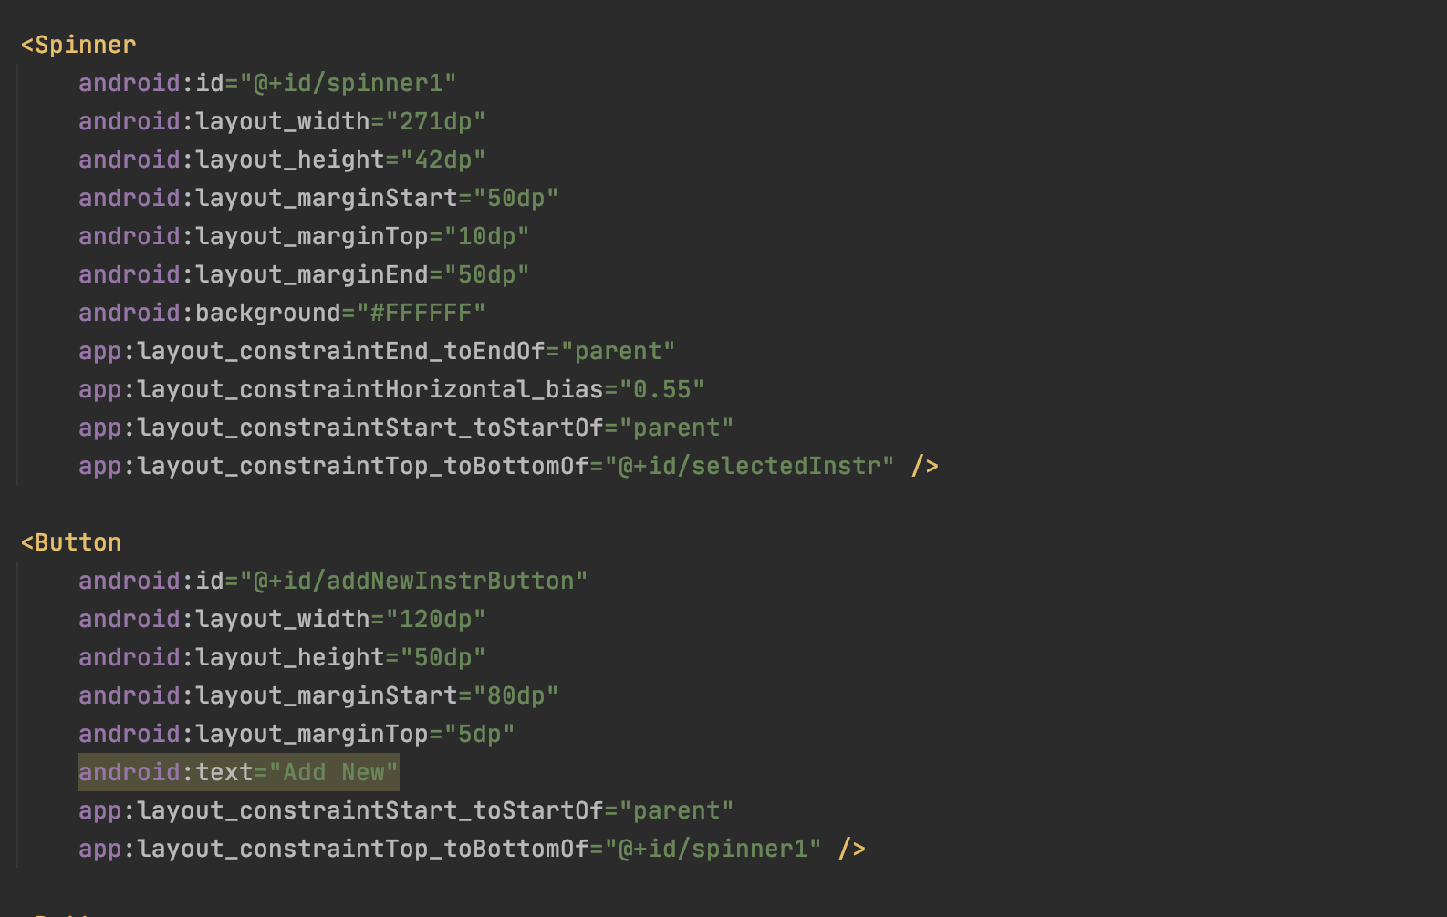
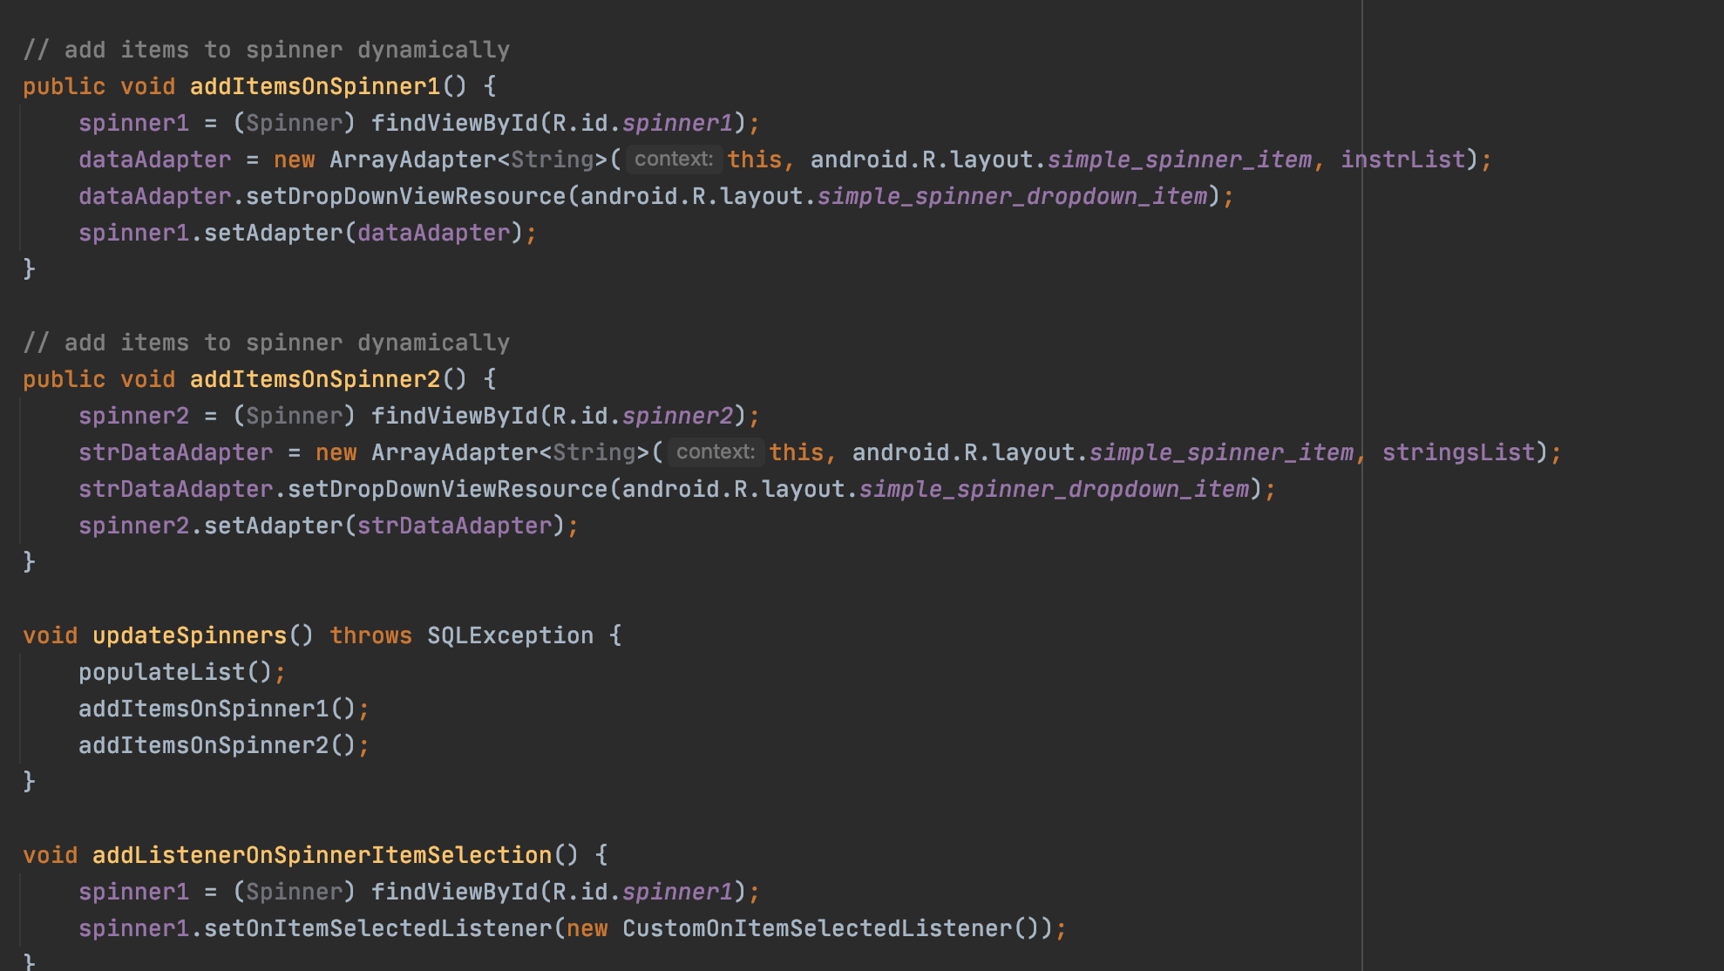
Implementation: Code Snippets
Spinner code
Spinner implementation

Slide 20
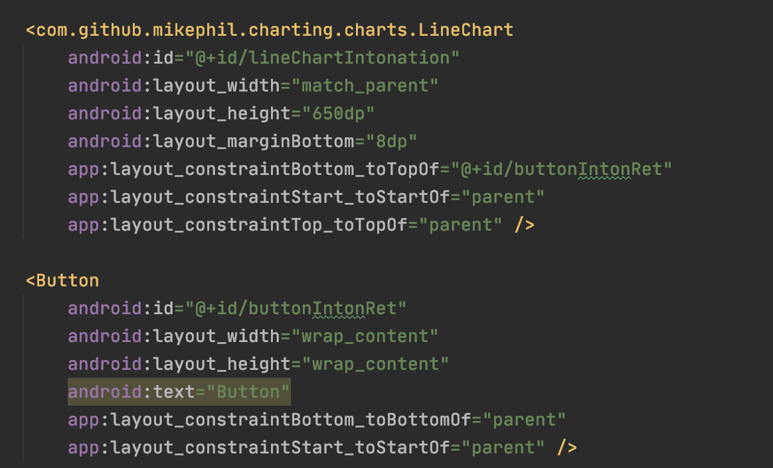
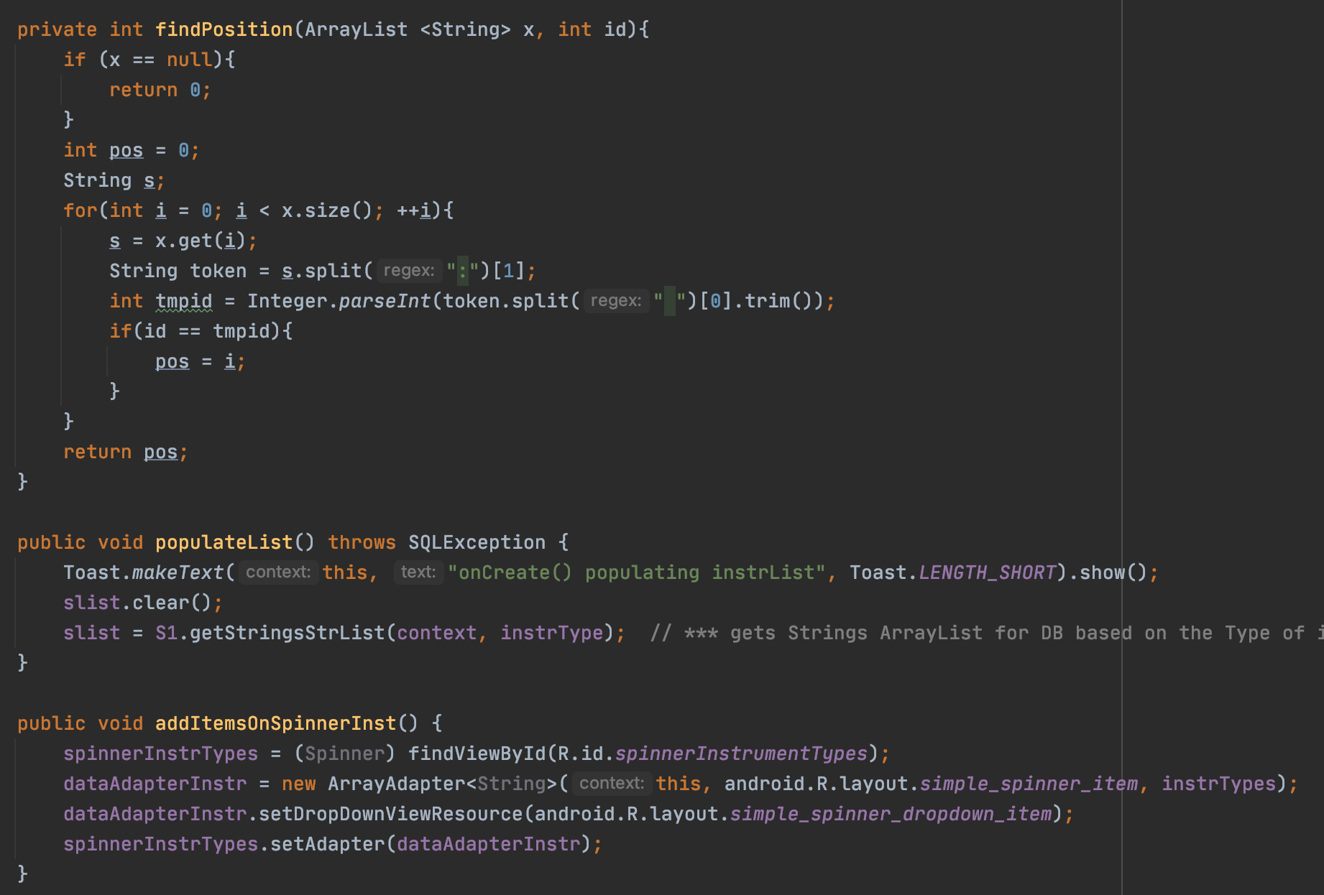
Implementation: Code Snippets
Graph code
Graphing lines code

Slide 21
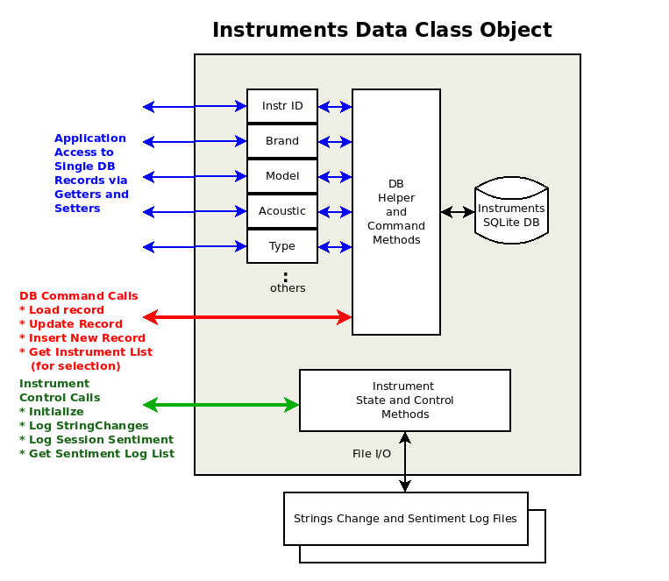
Implementation: Data Classes
Instrument Database

Slide 22
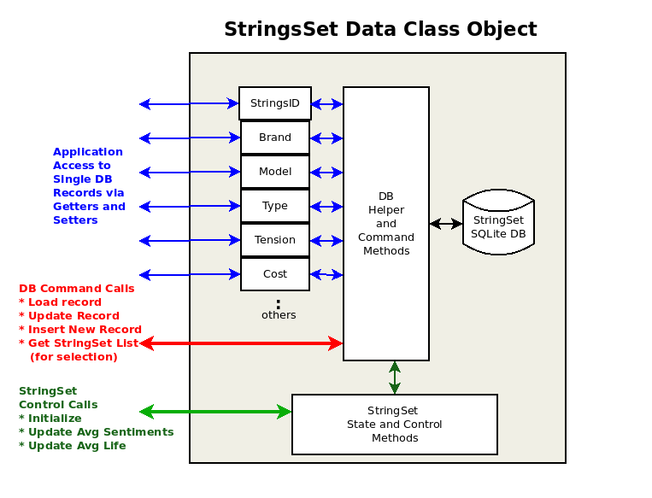
Implementation: Data Classes
String Database

Slide 23
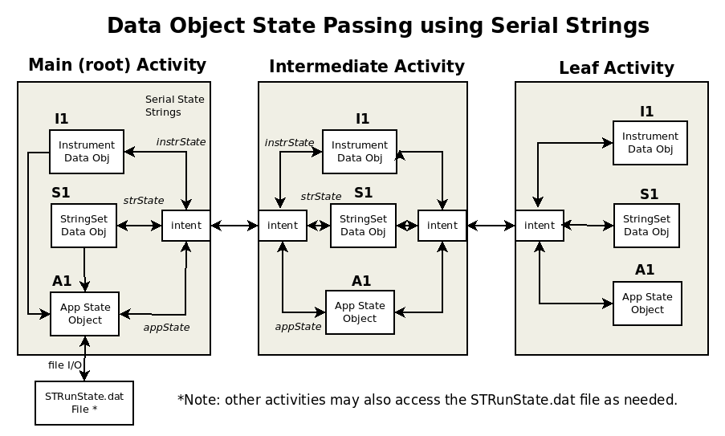
Implementation: Data Classes
Database Flowchart

Slide 24
Difficulties and Challenges
The difficulties we had:
Implementing data classes and database
Getting spinners to work
Making graphs
Application state data persistence and storage

Slide 25
Demo

Slide 26
Any Questions
Do you guys have any questions? Please feel free to ask-- we’re happy to answer!

Slide 27
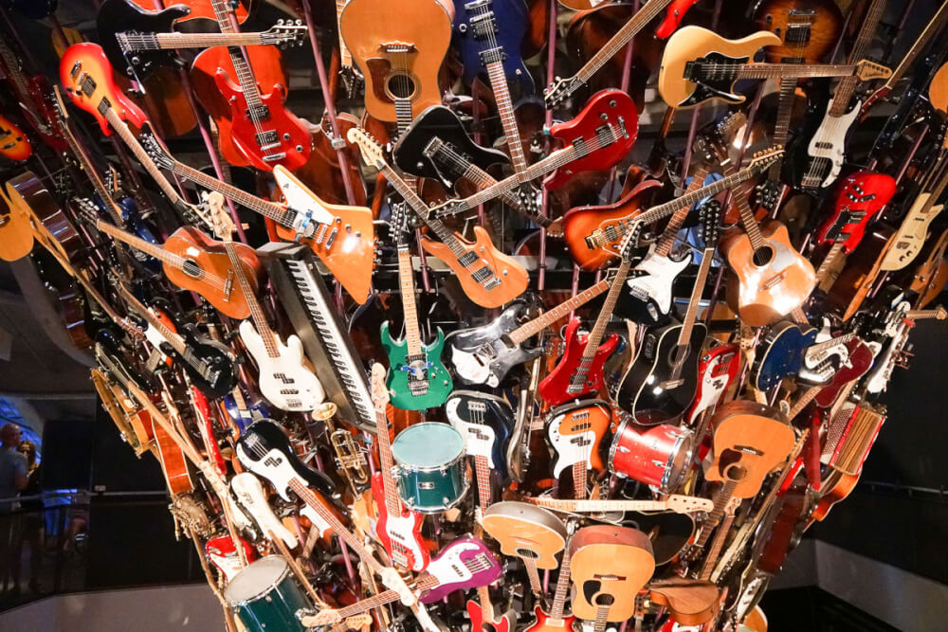
Thank you !!!!!!

